Slide 1
An investigation into the usefulness of the Smart Watch Interface for university students
Investigator:
Kyle Johnson
Project Supervisors:
Prof. Hannah Thinyane
Mrs. Ingrid Siebörger

Slide 2
This seminar covers
Quick recap of the project
Project progress / findings so far
Where to next?

Slide 3
The Project
Different target audiences would want a smart watch for different things.
Here we investigate whether the smart watch can be a potentially useful device to university students (student-device interaction)
The type of information (applications) which would be considered the most useful by students on a smart watch.

Slide 4
The Project
So why would students want to use a smart watch?
Would the access to this information be easier on the smart watch or smart phone interface? (Perhaps in particular circumstances?)
Questions to be answered via proof of concept applications requested by CS1L.

Slide 5
First some demographics
Total class size = 211 Number of participants = 89

Slide 6
Year of study & Majors

Slide 7
Questionnaire findings
Majority of respondents were interested in using a
smart watch for data retrieval
Convenience of an always accessible on-wrist interface
Physical security of having device attached to arm
Similar features to smart phone with added portability
Curiosity for new tech

Slide 8
More findings
Possible perceived deterrents found when using a smart watch as per the questionnaire:
Both devices can access the same information (Why use a watch when you can use a phone?)
Adaptation to a new interface can be intimidating to users. They need to be motivated to learn how to use a smart watch over already established interfaces.
Small screen and limited buttons for human-device interaction

Slide 9
Requested Apps
Applications which participants requested that would satisfy their data needs:
Proof of concept applications to ascertain their usefulness among students.

Slide 10
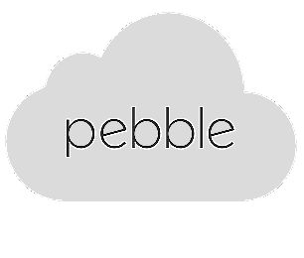
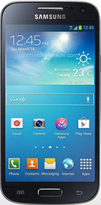
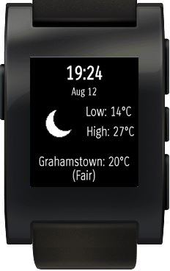
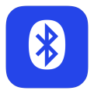
Development: from cloud to wrist
CloudPebble IDE
Using C with Pebble specific libraries
Sent via WiFi to Phone, Pebble control app
pushes watchapp / watchface to pebble
via Bluetooth
Compiled C
192.168.1.80

Slide 11
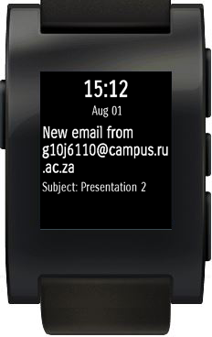
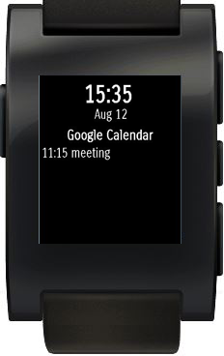
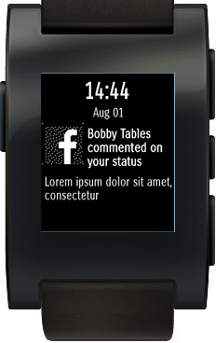
Development: Notifier Application
1. Weather
2. Email
3. Calendar
4. Social Networking

Slide 12
Development: Notifier Application
Developed to demonstrate the use of notifications sent from the phone -> Pebble and as a proof of concept to satisfy the user app requests in the questionnaire.
Control app will send notification messages to the Pebble in response to any relevant information received on the phone.
Highlights the mechanism used to push information from phone to watch.

Slide 13
Development: Notifier Application
The screen layer and its children layers are displayed on the Pebble based on these notification messages.
Demonstrates an application based on what the participants of the survey wanted. Familiarization with the IDE and the anatomy of a Pebble application.

Slide 14
Notifier App: Email Demo

Slide 15
Where to next? … Testing
The first questionnaire used a broad scope of participants to gain data (low fidelity prototyping / large breadth on multiple features & tasks).
The second user study will be done to gain a deeper understanding of how users interact with the smart watch (High fidelity / testing specific apps based on first user study).
Fewer participants selected this time (5 – 10).
Sample for the 2nd questionnaire will be taken from a similar test sample as the 1st one. Also have a sample of expert users, 3 - 4 post-grad students for comparison.

Slide 16
Where to next? … Phone Finder Application
The 1st questionnaire asked participants to give ideas of an
interesting and potentially useful app which they would use. A number said they would like a phone finder app.
Review of existing phone finder apps revealed the following:
No bypass of Android phone state (mute to loud) in order to force sound output (no multi-modality support).
Most are not free
Have limited methods to find a phone (Ringing / vibration most popular)
Have unnecessarily complicated native companion apps installed on Android phone

Slide 17
Phone Finder Application
The new implementation takes these into consideration.
Need to allow for multiple options for finding a phone (visual, aural, haptic)
eg. Bluetooth signal strength can determine phone proximity, succession of watch vibrations increase in frequency the stronger the signal gets.
Minimal companion app to be installed on phone to allow for the change of phone states and access to multi-media libraries.

Slide 18
Still to do…
Complete Development of the phone finder application.
Perform the 2nd usability test with both the notifier and phone finder apps.
Write up on the findings.

Slide 19
